Slide 1
THE POWER OF WORDS Home to Me
Level: Grade 4

Slide 2
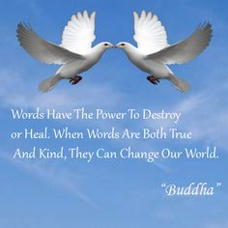
Level: Grade 4
Words…
“The color of the skin makes no difference. What is good and just for one is good and just for the other, and the Great Spirit made all men brothers. ” – Chief White Shield
“All birds, even those of the same species, are not alike, and it is the same with animals and with human beings. The reason Wakan Tanka does not make two birds, or animals, or human beings exactly alike is because each is placed here by Wakan Tanka to be an independent individuality and to rely upon itself. “ – Shooter, Teton Sioux
“Treat the earth well: it was not given to you by your parents, it was loaned to you by your children. We do not inherit the Earth from our Ancestors, we borrow it from our Children.” – Crazy Horse, Lakota/Oglala

Slide 3
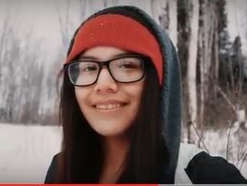
Level: Grade 4
About N’we Jinan: http://nwejinan.com/tour/
To listen to the song: Home to Me
http://nwejinan.com/home-grassy-narrows-first-nation-song-released/

Slide 4
Level: Grade 4
N’we Jinan, Home to Me, Grassy Narrows First Nation
Keep the old ways that we've always had it still lives inside this is a place, where we love the land let's work to show our pride
keep us safe, keep us free like it used to be don't want to be tied down
We find love where we're from and beat against the drums it's a beautiful sound
From the ground up, we'll find a path home feel pulled by the sun, wish I can go we learned from the past now we can grow we're promised a chance let the plans show
go big, go far, there are no limits I want to see change so my soul lives it they cut down our trees while we blow kisses defend our home while they dismiss us
Gete Ishkonigan it feels like home to me
Taapshko Endaayaan it feels like home to me
Don't be afraid when you're falling in fast there's something in the unknown
I held onto my culture it's been calling me back there is a story of hope
Winds of change, long ago hear the chants, far and low our voices cried out for rain
then it rained, brought us life gave us faith, gave us sight to see that we shall remain
Let your spirit soar as far as you can try not to be reminded by the scars from the past rise from the ruins, keep protecting the land don't take it for granted, can't neglect what we have stand together as a nation, express what we feel
True conversation and address what is real connected to the land, we are one with each other this is our home to discover
Gete Ishkonigan it feels like home to me
Taapshko Endaayaan it feels like home to me
sometimes it's hard to find the words to say your home to me
Gotta stay on point like the fastest arrow bring hope to the people of Grassy Narrows want peace in the land, can't go back to battles 8th fire in action, casting shadows from the old to new, let us show you the truth light up the path, there's a glow in the youth boozhoo to the world, this is where we live so let the journey begin
Mixed and produced by David Hodges
ARTISTS: Sharice Bruce, Dylan Fobister, Jimi Fobister, Preston Paul ,Darwin Fobister, Janessa Kejick ,Damien Kejick, Ashley Fobister, Linda Fobister, Paul Cedric Oteskan, Edmond Jack & Josh Bigblood.

